Slide 1
SIMM 32
Lab 7 – Sample size planning and statistical power

Slide 2
Statistical conclusion validity

Slide 3
Statistical conclusion validity
Whether there is a relationship between the two variables: treatment (cause) and outcome (effect)
We contrast two hypothesis:
Alternative hypothesis (H1): The decrease in PTSD symptom scores is greater in the EMDR group compared to the control group.
Null hypothesis (H0): The decrease in PTSD symptom scores is NOT greater in the EMDR group compared to the control group.

Slide 4
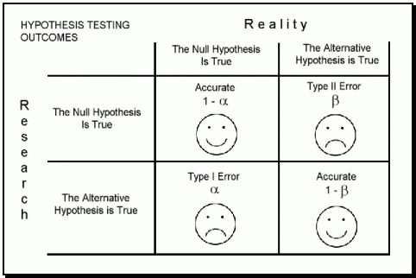
No effect
Effect
Conclude No effect
Conclude Effect

Slide 5
Null hypothesis significance testing (NHST)
The p-value is used for hypothesis testing in NHST.
The p-value shows the probability of observing a difference/correlation at least as great as the one observed in the study, if the null hypothesis is true
p = 0.17 tells us that
if H0 was true, there is still a 17% chance that we would observe a result at least as high or higher as we observed in our experiment.
Using a p = 0.05 threshold for statistical inference assures that there is a 5% chance for the type I error across studies using this threshold on the long run.
However it cannot give assurances about any single studies results.

Slide 6
Ensure that the type I error rate is consistent
Make sure that the assumptions of the statistical tests are met.
Account for non-idenpendence of observations (e.g. use mixed models)
Normality
Homoscedasticity
Adjust for multiple testing
If the Type I error rate is set at the conventional 0.05 for each single test, the actual rate of making a Type I error increases with multiple testing:
3 tests: α = 0.143
20 tests: α = 0.642
50 tests: α = 0.923
Statistical corrections for multiple testing
E.g. Bonferroni correction (critical p-value/number of tests)
Report all tests
Don’t do ‘salami publication’
Report all results, not just those that “tell a good story”
Pre-registration
Reporting exact p values and confidence intervals

Slide 7
Null hypothesis significance testing (NHST)
Problems with NHST:
We can only say whether there is enough evidence to reject H0 or not. So we can never really find evidence supporting H0, we can only reject it or not reject it yet.
We cannot reject or claim evidence against H1 with NHST.
P-values are counterintuitive. It is easy to misinterpret p-values. It indicates the probability of the observation in light of the hypothesis, when in reality we are interested in the probability of the hypothesis being true.
People often mistake the p-values for effect size indicators

Slide 8
Null hypothesis significance testing (NHST)
Recommendation:
Don’t just rely on p-values when reporting data. Report effect size and 95% confidence interval. E.g. Instead of saying: “Consuming five units of alcohol daily will reduce IQ (p = 0.03).” We could say: “We are 95% confident that consuming five units of alcohol daily will reduce IQ by somewhere between 6 and 18 points on average. (mean = 12, 95% confidence interval = 6-18)”
Interpreting confidence interval: if many samples are collected, 95% of the confidence intervals calculated the same way for these samples will contain the true population mean. In other words: We are 95% confident that the population mean is somewhere between these two values.
Demonstration of confidence intervals: https://rpsychologist.com/d3/ci/

Slide 9
Bayes factor
Bayes factors indicate the likelihood of the hypotheses given the data.
Can quantify statistical support for H0 relative to H1 and vice versa.
For example a Bayes Factor (H1 vs. H0) = 10 shows that it is 10 times more likely to observe outcomes we just observed in a world where H1 is true compared to where H0 is true. (If before observing the data we thought that the likelihood of the two hypotheses were equal).

Slide 10
No effect
Effect
Conclude No effect
Conclude Effect

Slide 11
Power
Power is the probability of a study design to detect an effect if it really exists (the inverse of the chance of type II error, thus, power is 1- β).
Refers to the probability of the test to detect the targeted relationship if it exists in the population
Refers to the probability that the test will reject the null hypothesis when it is false
Traditionally, a 80% power is considered acceptable, but lately this is closer to 90%.
Demonstration of statistical power: https://rpsychologist.com/d3/nhst/

Slide 12
Low Power
Low sample size and high measurement error/variability compared to the size of the effect leads to low power
Increases chance for Type II error (not detecting the treatment effect)
Power analysis – calculate necessary sample size for a study when the study is planned
Need to provide:
Statistical test to be used
effect size (e.g. from previous studies)
Type I error probability: α (conventionally this is set to 0.05)
Type II error probability : β (conventionally this is set to 0.20)
Can be done by e.g. G*Power free software.

Slide 13
How to increase power – reduce error
Decrease “random” variation
Within-subjects design
But: fatigue, practice, contamination effects
Matching, stratification, blocking
On variables that correlate with the outcome
Adjusting for covariates correlated with the outcome
Reduce random setting irrelevance: if possible, do the research at one site/setting only
Decrease measurement error
Use more reliable measures
Don’t dichotomize continuous variables
Avoid floor and ceiling effect
Use the proper statistical test and ensure their assumptions are met
E.g. transformation to normality
Standardization
Increase sample size
Even increasing control group sample size only can help

Slide 14
How to increase power – increase effect
Increase strength of treatment
Dose
Reduce spill-over to control
Reliability of delivery
Increase the variability of treatment
Measure at more measurement points
Take more sample at the extreme levels of treatment
Select only responsive participants
But: can reduce generalizability (e.g. high hypnotizables are only about 15% of the population)

Slide 15
Effect size

Slide 16
Effect size – Different measures
Association of different types of variables:
Discrete - continuous: SMD (e.g. cohen’s d, hedges g)
Discrete – Discrete: Risk Difference (RD), Risk ratio (RR), Odds Ratio (OR)
Continuous-continuous: correlation (r), R^2
There are many other effect size measures (eta^2, f, etc. depending on the statistical test).

Slide 17
Effect size – Different measures
Association of different types of variables:
Discrete - continuous: SMD (e.g. cohen’s d, hedges g)
Discrete – Discrete: Risk Difference (RD), Risk ratio (RR), Odds Ratio (OR)
Continuous-continuous: correlation (r), R^2
There are many other effect size measures (eta^2, f, etc. depending on the statistical test).

Slide 18
Hypnosis for weight loss

Slide 19
Hypnosis for weight loss
Participants in the hypnosis groups underwent a single hypnosis session and got suggestions like:
“Overeating is a poison to your body.”
“[specific problem food] is a poison to your body, just as overeating is a poison to your body.”

Slide 20
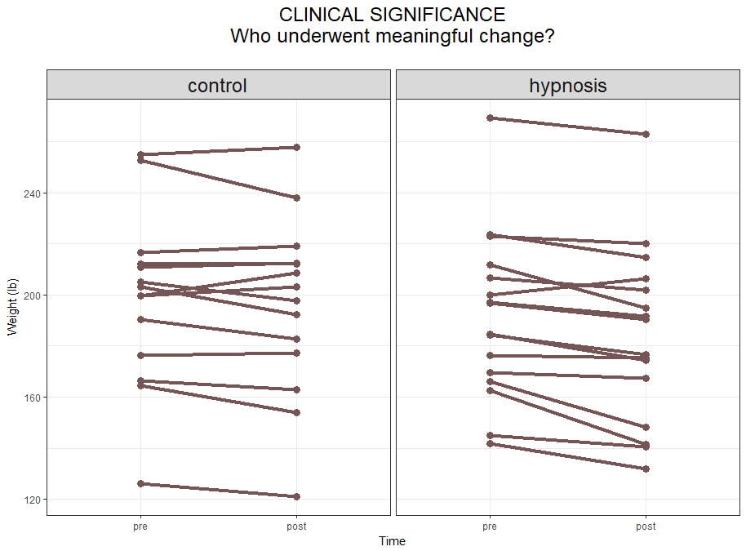

Slide 21
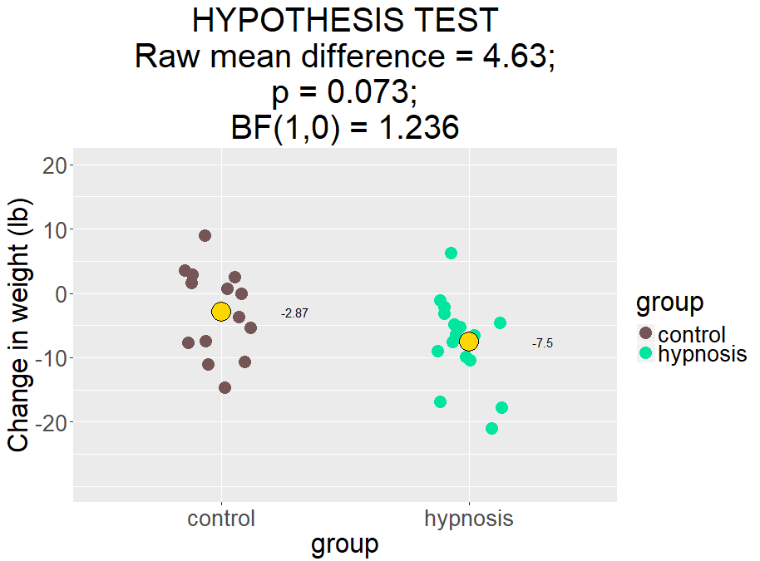

Slide 22
Effect size
Diff = 4.63

Slide 23
Significance, NOT effect size

Slide 24
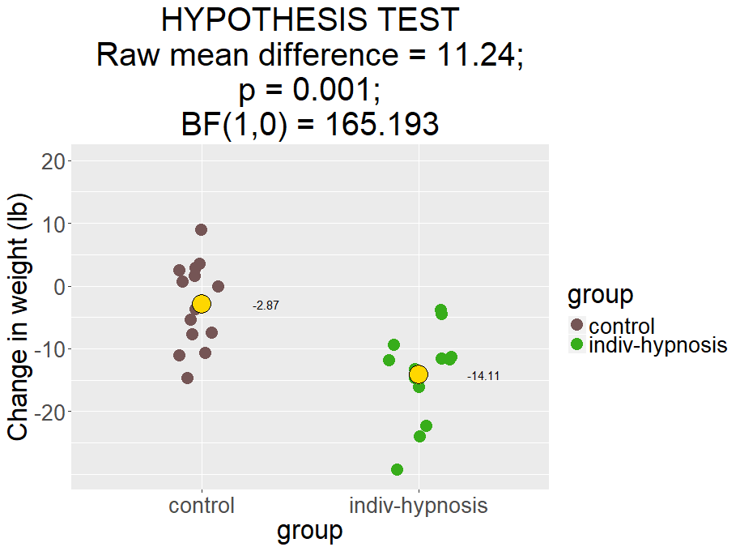

Slide 25
Effect size
How to report effect size?
11.24 lb weight loss [6.06 - 16.42]
Contains two components:
point estimate of the size of the effect
This is our best guess of the true average effect size in the population
interval estimate of the size of the effect
Shows precision of the estimate
How to interpret 95% confidence interval: If repeated samples were taken the same way, 95% of the intervals calculated the same way would contain the population mean.

Slide 26
Effect size – raw mean difference
Pros:
Intuitive to interpret
Clinical relevance is more apparent
Easy to calculate
Cons:
Not comparable with results of other studies using different measures
Not meaningful if the measure is not in common use

Slide 27
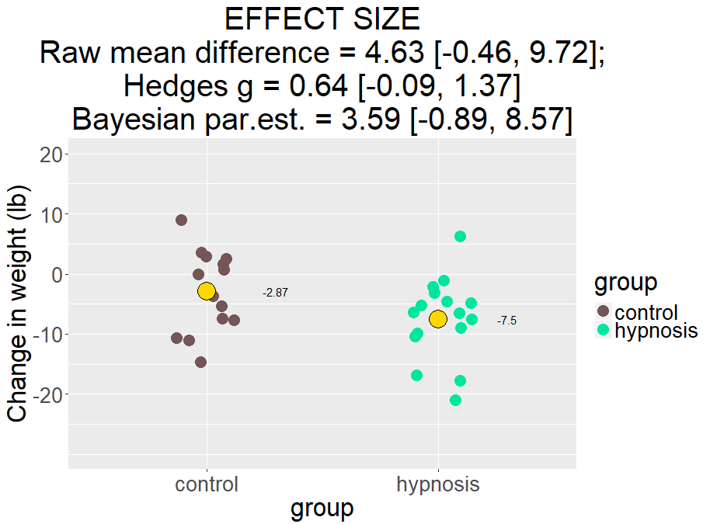

Slide 28
Effect size – standardized mean difference (SMD)
The raw mean difference devided by the pooled standard deviation.
e.g. cohen’s d, hedges g
So g = 1 means that the difference between the groups on average is 1SD
(Rule of tumb: 0.2-0.3 = small, 0.5 = medium, 0.8 = large effect)

Slide 29
Effect size – standardized mean difference (SMD)
Pros:
Comparable across studies and different measures
Can be used to aggregate evidence on a field
Meaningful even if the measure is not widely known
Cons:
Not so intuitive to interpret
Clinical relevance is not apparent

Slide 31
Effect size – Different measures
Association of different types of variables:
Discrete - continuous: SMD (e.g. cohen’s d, hedges g)
Discrete – Discrete: Risk Difference, Risk ratio, Odds Ratio (OR)
Continuous-continuous: correlation (r), R^2
There are many other effect size measures (eta^2, f, etc. depending on the statistical test).

Slide 32
Relationship between discrete variables
Risk difference (RD)
Risk ratio, also called relative risk (RR)
Odds Ratio (OR)

Slide 33
Chances of pregnancy after a single intercourse with and without a condom
RD = 0.001-0.05 = -0.049
RR = 0.001/0.05 = 0.02
OR = (0.001*0.95)/(0.05*0.999) = 0.019

Slide 34
Interpretation
RD: The chance of pregnancy was 4.9% lower in the condom group compared to the no protection group.
RR: The chance of pregnancy in the condom group was 2% that of the chance of pregnancy in the no protection group. (In other words the chances of pregnancy was 50 times lower in the condom group compared to the no protection group).
OR: The odds of getting pregnant vs. not getting pregnant in the condom group was 1.9% that of the same in the no protection group. (The odds are roguhly 52 times in favor of the no protection group for of getting pregnant vs. not)

Slide 35
Chances of not getting pregnant after a single intercourse with and without a condom
RD = 0.999-0.950 = 0.049
RR = 0.999/0.95 = 1.05
OR = (0.999*0.05)/(0.95*0.001) = 52.58

Slide 36
Chances of not getting pregnant after a single intercourse with and without a condom
RD = 0.999-0.950 = 0.049 (prev. -0.049)
RR = 0.999/0.95 = 1.05 (prev. 0.02)
OR = (0.999*0.05)/(0.95*0.001) = 52.58 (prev. 0.019)

Slide 37
Interpretation
RD: The chance of not getting pregnant was 4.9% higher in the condom group compared to the no protection group.
RR: The chance of not getting pregnant in the condom group was 5% higher than the chance of not getting pregnant in the no protection group. (In other words the chances of not getting pregnant was just 1.05 times higher in the condom group compared to the no protection group).
OR: The odds of not getting pregnant vs. getting pregnant in the condom group was 52 times that of the same in the no protection group. (The odds are roguhly 52 times in favor of the condom group for of not getting pregnant vs. getting pregnant)

Slide 38
Relationship between continuous variables
r - correlation
r^2 = R^2
R^2: proportion of variance in variable A explained by the variable B
R^2 = 0.5 means that 50% of the variation in one of the variables can be predicted by knowing the other variable

Slide 39
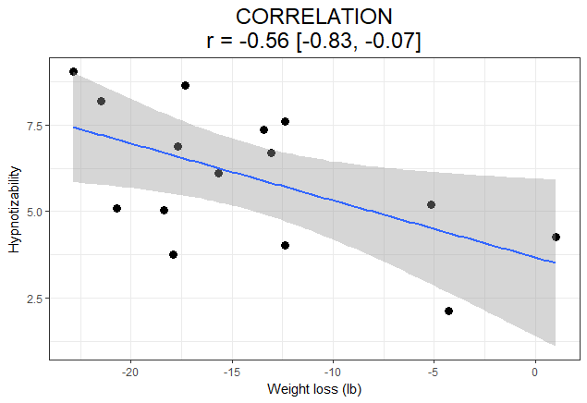
R^2 = 0.31

Slide 40
Effect size calculators
https://campbellcollaboration.org/escalc/html/EffectSizeCalculator-Home.php
https://www.psychometrica.de/effect_size.html
Convert between different effect sizes: http://escal.site/
Excellent guide on using g*power: http://www.mormonsandscience.com/gpower-guide.html

